Slide 1
Introduction to R Programming
Beckerman et al. p. 1-28
Notes:
Content originally developed by Trevor Branch (UW Fisheries)

Slide 2

What is R?
R is a computer language, an environment for statistical computing, graphics, and much more
It is open source with great flexibility and power gained from contributions by many users
It allows anyone using any operating system to reproduce your work from data to finished analysis
It is script-based (text computer code) and not GUI-based (point and click with menus)

Slide 3
What is R
An effective data handling and storage facility
A large, integrated collection of tools for data analysis
A large and highly flexible collection of graphing facilities for data display
A well-developed and relatively simple programming language
Conditionals (if-then-else), loops (for, while), user-defined functions, input and output

Slide 4

What R is not
Pirate eye-chart
It is not fast (C++ and Python are much faster)
There is a limit to the size of data that can be processed
There is a learning curve (its free, but its not cheap)
Debugging is difficult
Posted by @utterben on Twitter

Slide 5
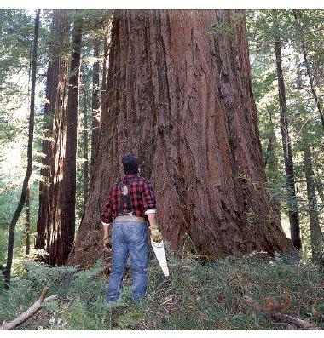
What about Excel?
Excel allows quick prototyping
Data manipulation is easy
Can see what is happening
But: graphics are poor
Looping is hard
Limited statistical capabilities
Inflexible
Workflows are not transparent or repeatable
There are some things Excel just cannot do
Use the right tool!

Slide 6
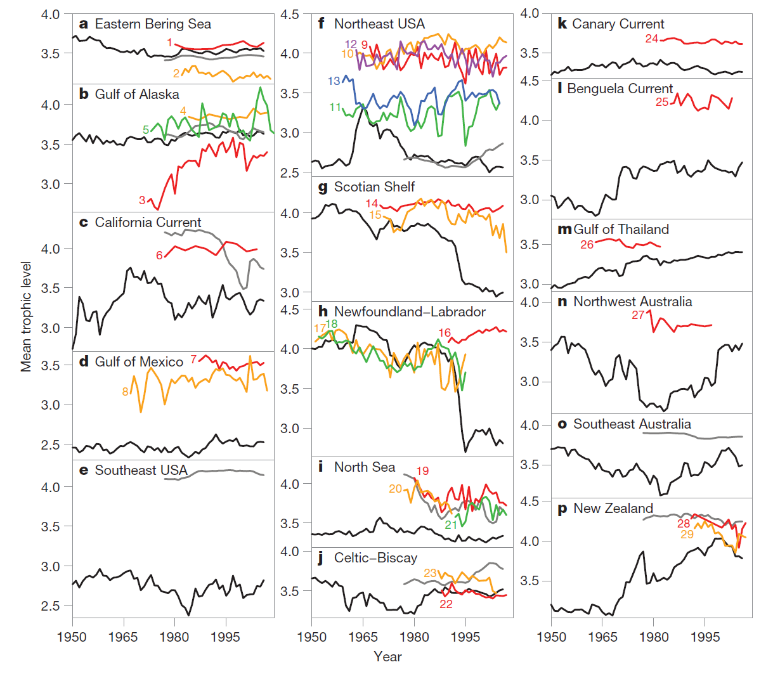
There are many things Excel cannot do
Branch et al. (2010) Nature 468:431-435

Slide 7
What about JMP? I used that in Biostatistics…
JMP is very easy to use, fully featured, very mature (continual development for over 20 years)
Has almost all traditional and contemporary statistical methods built-in.
Cannot make attractive figures/graphs (limited plotting)
“But, simple (reductionist) experiments should only require simple analysis techniques”; OK then JMP may be OK for you.
Very expensive ($1,500/year); no employer is likely to buy a copy.
Not widely used outside academia; but SAS is
Cannot do purpose-built or cutting-edge analytics; genetic analysis, proteomics, machine learning, spatial analysis, data science.
Cannot do modeling.
Workflows largely not repeatable (some scripting capability).
Difficult to generate reports that mix text, figures, analyses.
Does not generate web-based (.html) reports
Does not force an understanding of analyses; magic black box
Notes:
Personal license is ~$1,500/year
Teaching-grade vs. research grade

Slide 8
What are the strengths of R?
Comprehensive set of statistical analysis techniques
Classical statistical tests (t-test, ANOVA, regression)
Linear and nonlinear modeling
Time-series analysis
Classification and cluster analysis
Spatial statistics
Bayesian statistics
Genetic algorithms
Virtually every statistical and analysis technique is either already built into R, or a user-contributed package

Slide 9
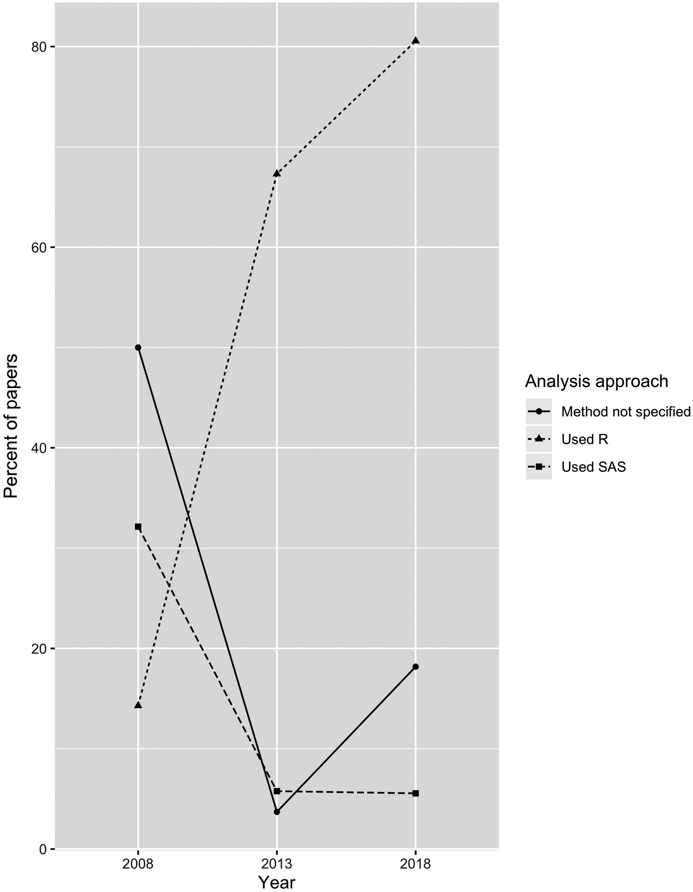
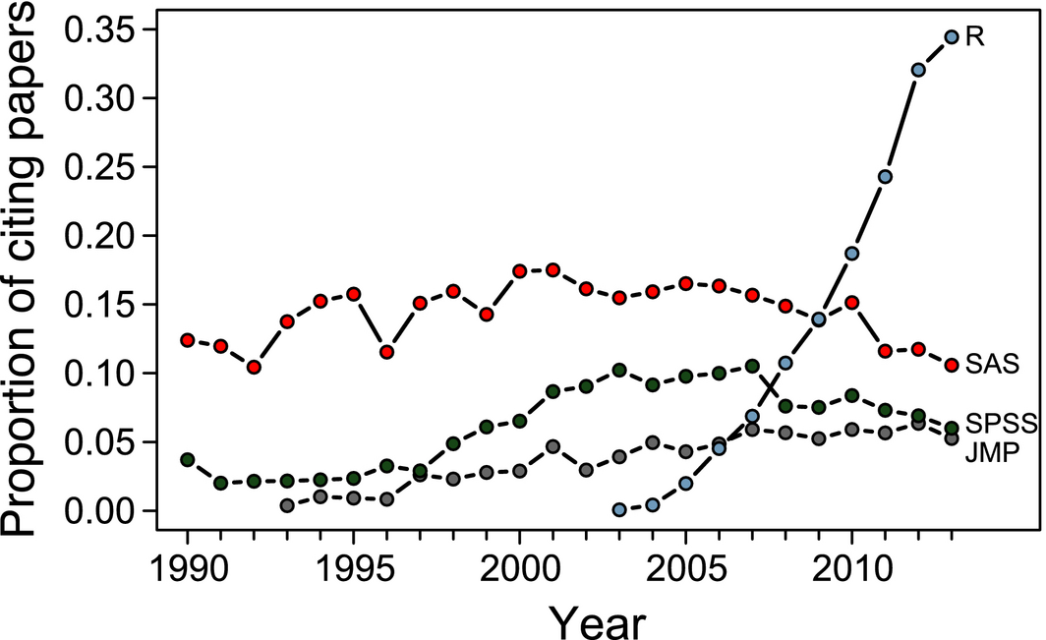
What are the strengths of R?
Completely open-source (Free)
Users contribute and create new packages
Existing R functions can be edited and expanded
Huge community of scientists using R
Easy to replicate your work from data
to finished product
Touchon and McCoy 2016
Auker and Barthelmess 2021
Notes:
Ecosphere Volume 7, Issue 8, 17 AUG 2016 DOI: 10.1002/ecs2.1394 http://onlinelibrary.wiley.com/doi/10.1002/ecs2.1394/full#ecs21394-fig-0003

Slide 10
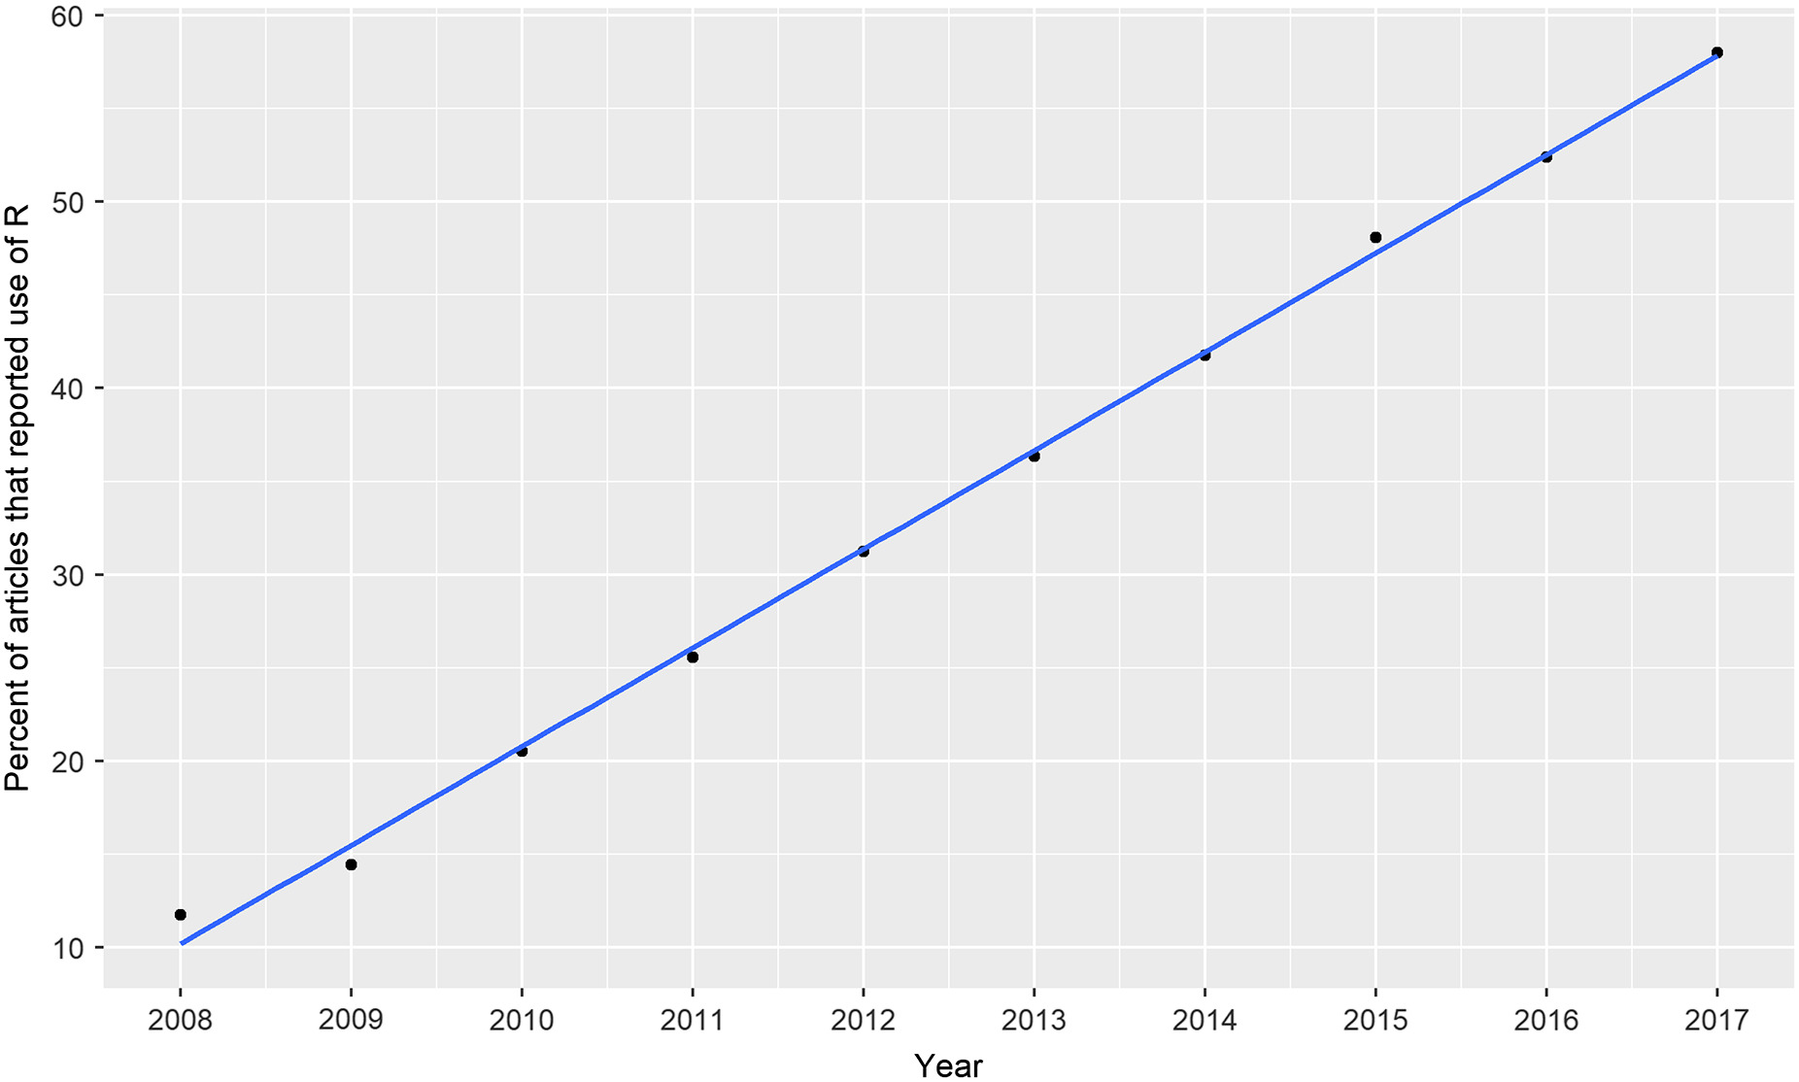
No seriously, everyone* is using R.
You will need it if you want a job.
Lai, J., Lortie, C. J., Muenchen, R. A., Yang, J., and Ma, K. 2019. Evaluating the popularity of R in ecology. Ecosphere 10( 1):e02567. 10.1002/ecs2.2567
Notes:
Lai, J., Lortie, C. J., Muenchen, R. A., Yang, J., and Ma, K.. 2019. Evaluating the popularity of R in ecology. Ecosphere 10( 1):e02567. 10.1002/ecs2.2567
* Cell-Molec-Micro labs have been slower to embrace R. Simple experiments can get away with using simple tools.

Slide 11
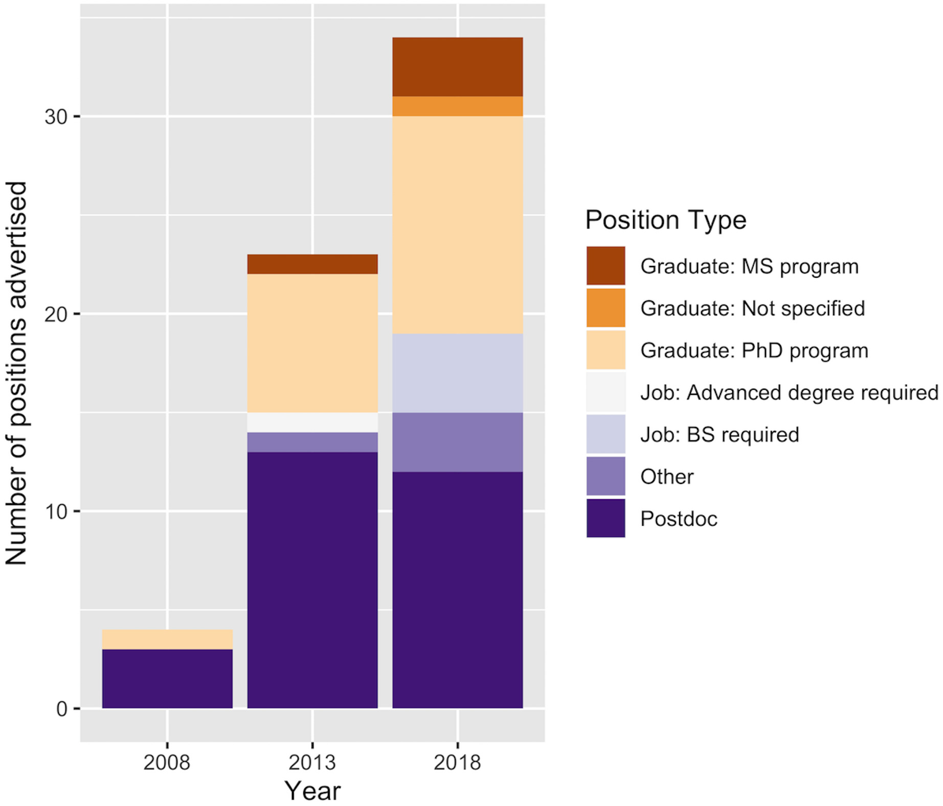
Becoming the default language of data analysis in biology
The distribution of position postings on Ecolog‐L requiring R in 2008–2009, 2012–2013, and 2017–2018. (Auker and Barthelmess 2021)
Notes:
Ecosphere Volume 7, Issue 8, 17 AUG 2016 DOI: 10.1002/ecs2.1394 http://onlinelibrary.wiley.com/doi/10.1002/ecs2.1394/full#ecs21394-fig-0003

Slide 12
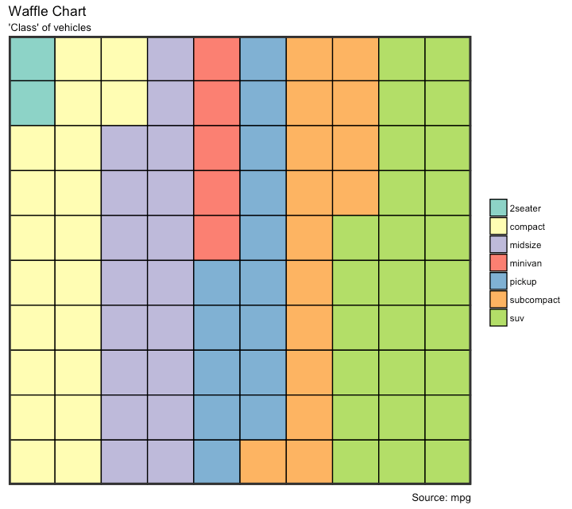
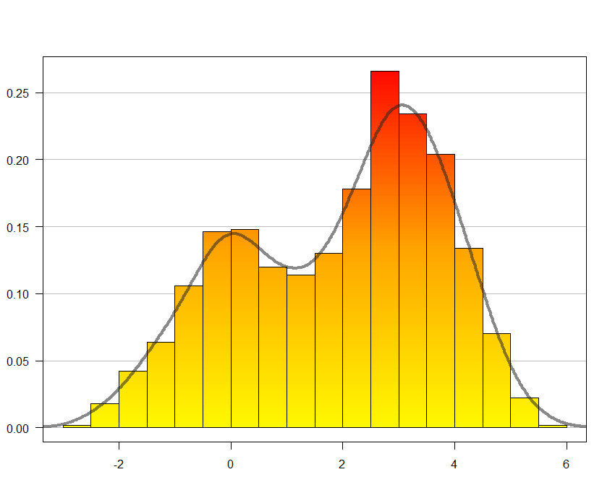
What are the strengths of R?
Publication-quality graphics
Many default graphics
Full control of graphics
Make even rudimentary plots
vibrant and exciting
Notes:
Ecosphere Volume 7, Issue 8, 17 AUG 2016 DOI: 10.1002/ecs2.1394 http://onlinelibrary.wiley.com/doi/10.1002/ecs2.1394/full#ecs21394-fig-0003

Slide 13
Learning R
R is a programming language, the learning curve can be steep (R is free, but its not cheap)
Very rewarding to become fluent
Be patient and creative
Lots of help files, online sources, books, and graduate students in your lab
Course readings
Books: R graphics (Murrell), The R book (Crawley), A primer of ecology with R (Stevens)
R reference card 2.0 (Baggott)
R-Studio ‘cheatsheets’ (Help→Cheatsheets)

Slide 14
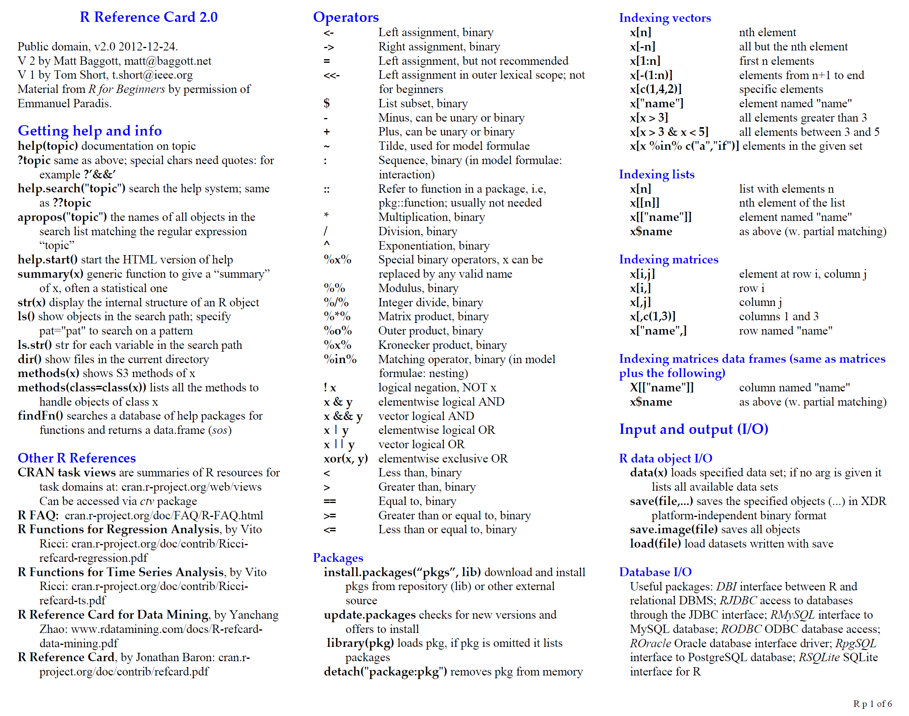
Notes:
R is a language….learn the lingo.

Slide 15
Online reference material
The R project website
http://www.r-project.org/
R seek (specific R search engine)
http://www.rseek.org/
Google it… “r” returns R
Very often someone else has had the same problem
StackOverflow
http://www.stackoverflow.com/

Slide 16
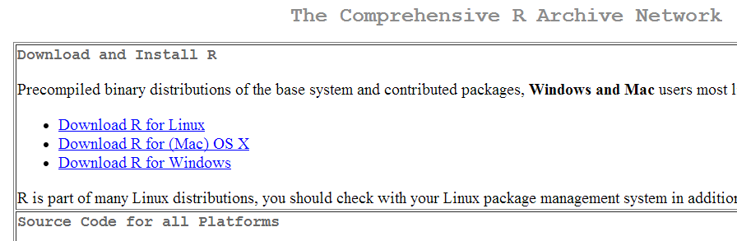
Where to get R
The program can be downloaded from one of the official mirrors of CRAN
http://cran.r-project.org/
Download the appropriate compiled binary code for your operating system

Slide 17
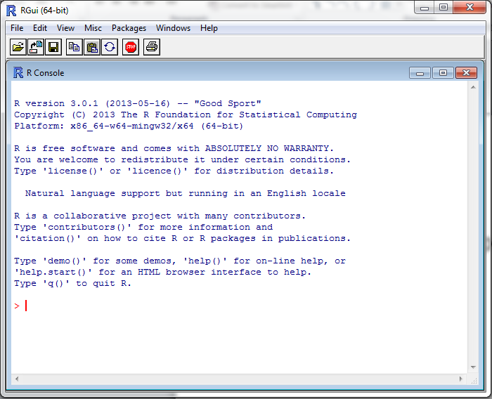

Load up R
Find the standalone R program
Open it
Enter commands at the > sign, e.g.
> 2 + 4
> x <- 7
> x + 19
The > is the R
command prompt
This font means this is an R command

Slide 18
What is R doing?
The [1] means the first element of a vector
Even a single number in R is a vector, so “6” is a vector of size 1
> 2+4
[1] 6
> x <- 7
> x + 19
[1] 26
> X + 10
Error: object 'X' not found
<- means “assign” in this case “assign the value 7 to the variable x”
Some use = for this purpose but it is frowned upon
Adding 19 to x gives the expected value of 26
X is not the same as x
R is case sensitive: upper case letters are different to lower case letters

Slide 19
Rstudio: An Integrated Development Environment
It is tedious to write R code in the command line
Old style: create a text file (e.g. Notepad) and copy the code you want to run, to the command line
Much better: use RStudio. Why?
Multiple input-output files
View variable values, color coding
Built-in help
Quick running of code
Easy file handling
Easy package installation
Many other reasons

Slide 20
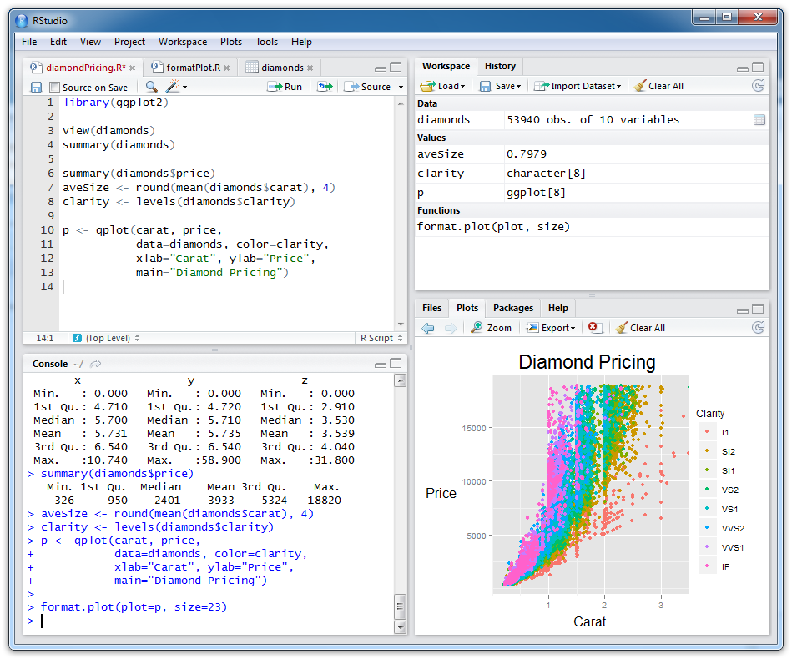
Scripts (files
with R code)
Objects you have created
Plots and help
R console (results from
running R code)

Slide 21
Help from within R
Getting help for a function
> help("log")
> ?log
Searching across packages
> help.search("logarithm")
Finding all functions of a particular type
> apropos("log")
[7] "SSlogis" "as.data.frame.logical" "as.logical" "as.logical.factor" "dlogis" "is.logical"
[13] "log" "log10" "log1p" "log2" "logLik" "logb"
[19] "logical" "loglin" "plogis" "print.logLik" "qlogis" "rlogis"

Slide 22
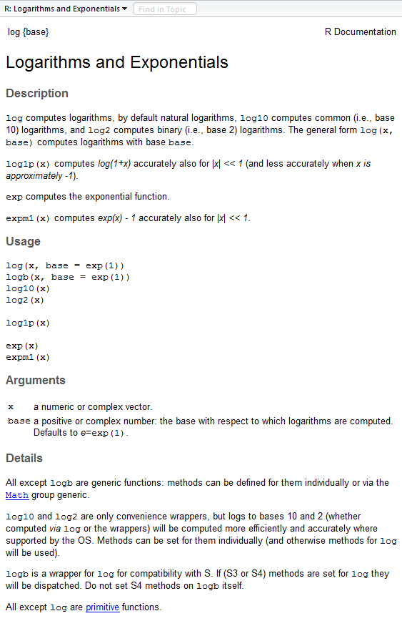
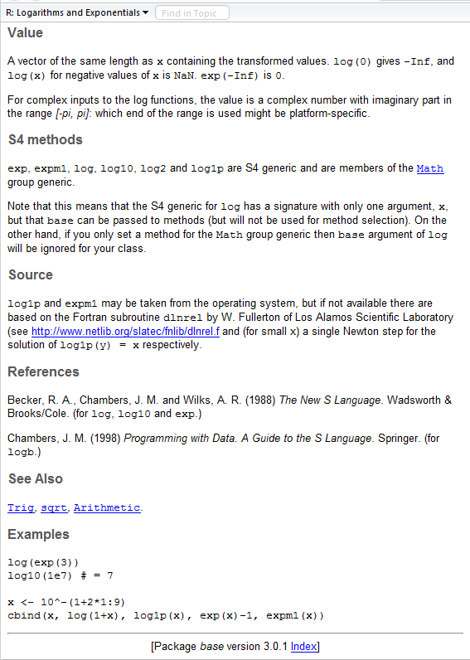
?log
What does the function return
What the function does in general terms
How to use the function
What does the function need
Discover other related functions
Sample code showing how it works

Slide 23
R scripts
A text file (e.g. lab1.r) that contains all your R code
Good practice because it’s a complete record of your analyses
Reproducible: rerunning your code is easy for you or someone else
Easily modified and rerun
In RStudio, select code and type <ctrl+enter> to run the code in the R console
SAVE YOUR SCRIPTS (unsaved scripts have red title)

Slide 24
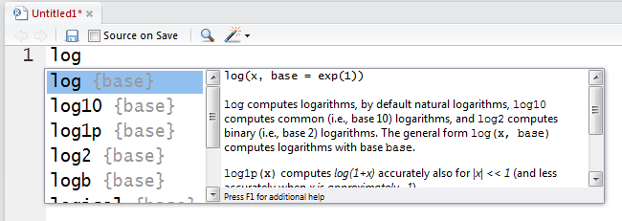
RStudio quick help
Start typing in the Scripts window (top-left)
Press <tab> and a list of available functions starting with those letters appears, plus help
S
S
S
S
Ss
Try typing log( and then pressing <tab>

Slide 25
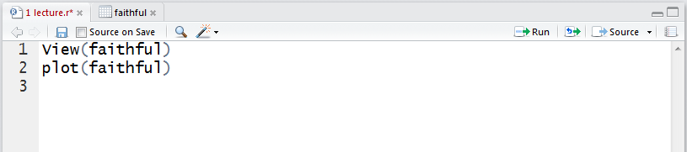
RStudio tips
Sends current line or selection to console (faster to type ctrl+enter)
Sends entire file to R console
Re-send the lines of code you last ran
(useful after edits)

Slide 26
Commenting your code (do it)
Use “comments” to document the intention of your code
Anything on a line after # is ignored by R
# Old Faithful Geyser, Yellowstone NP
plot(faithful)
Rules of thumb
Document the purpose of the code not how it works
Use good variable names
Assume you will remember nothing about the code when you look at it later (next week, year, decade)
RStudio: different color for comments

Slide 27
Some simple R commands
> 2+2
[1] 4
> 3^2
[1] 9
> sqrt(25)
[1] 5
> 2*(1+1)
[1] 4
> 2*1+1
[1] 3
> exp(1)
[1] 2.718282
> log(2.718282)
[1] 1
> log(10, base=10)
[1] 1
> log(10
+ , base = 10)
[1] 1
Result of the command
Optional argument
Order of precedence
Incomplete command

Slide 28
R workspaces
When you close your R session, you can save data and analyses in an R workspace
This saves everything run in your R console
Generally not recommended
Exception: working with an enormous dataset
Better to start with a clean, empty workspace so that past analyses don’t interfere with current analyses
rm(list = ls()) clears out your workspace
Summary: save your R script, don’t save your workspace

Slide 29
In-class exercise 1
Use R to do the following. Create a new script to save your work, and remember to use driver & navigator roles
1 + 2(3 + 4)
ln(4³+3²⁺¹)
File = 1 Lecture r code.r on D2L

Slide 30
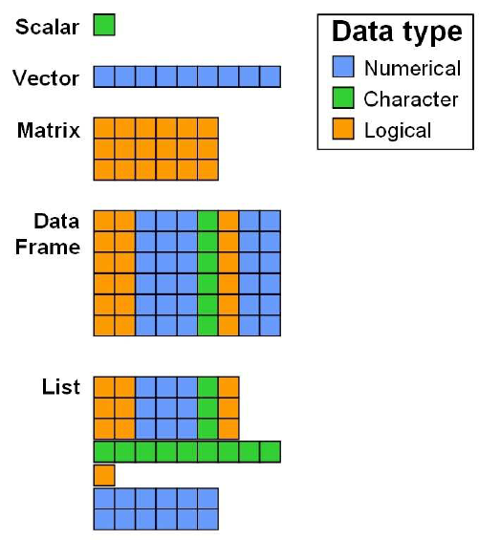
Objects
Every programming outcome in R can be stored as an object
Numbers
Characters (i.e. text or strings)
Tables
Vectors and matrices
Plots
Statistical output
Functions
Good names for objects are critical
Objects in R are global

Slide 31
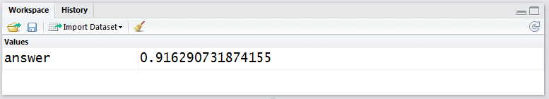
Assigning values
Assign the result of log(2.5) to a new object called “answer”
answer <- log(2.5)
answer = log(2.5)
answer <- log(2.5, base=10)
= can be used instead of <- but is frowned upon
optional argument
When you run this command, an object “answer” is created in the workspace that is assigned the value of 0.91629… In RStudio, the top right window lists all the objects in the current workspace

Slide 32
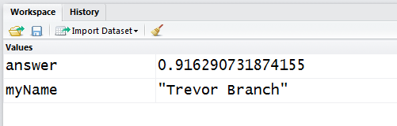
Assigning values
myName <- "Trevor"
myName <- 'Trevor'
> (myName <- "Trevor Branch")
[1] "Trevor Branch"
Characters can also be assigned to objects
Usually we use double quotation marks, but single quotes are treated the same
Surrounding a command in ( ) will display the assigned value in the R console
Can include spaces

Slide 33
What is an object name?
Each cell is part of the memory (RAM) of a computer
Object names are human-convenient “pointers” that “point” at a memory location (e.g. 0x3A28213A) for the computer to look up
myName
answer
 |  |  |  | 0.91
 |  |  |  | Trevor

Slide 34
Viewing objects
RStudio: just look at the top-right Workspace tab
Alternatively (and more generally):
> print(answer)
[1] 0.9162907
> answer
[1] 0.9162907
> answer * 10
[1] 9.162907
Very general command, works on everything
Manipulate the value contained within the object

Slide 35
Removing objects
To find a list of all objects in the workspace
> ls()
[1] "answer" "myName"
To remove an object
> rm(answer)
> ls()
[1] "myName"
To remove all objects
> rm(list = ls())
> ls()
character(0)
Or Workspace/Clear All menu option in RStudio
Useful for clearing your workspace at the start of a new session
Nothing left in workspace

Slide 36
Data types
Data types describe how objects are stored in computer memory
In R, you do not need to specify the data type
Common data types (also known as mode) include
Numeric (integer, floating point numbers or doubles)
Logical (Boolean, true or false)
Characters (text or string data)
The object type is not always obvious in R, and knowing what it is can be important

Slide 37
Finding data types
> answer <- log(2.718282)
> answer
[1] 1
> mode(answer)
[1] "numeric"
> is.numeric(answer)
[1] TRUE
> typeof(answer)
[1] "double"
> answer <- as.integer(answer)
> typeof(answer)
[1] "integer"
Is it numeric or text?
Part of a family of is. functions
Specifically, what type of object is it?
The as. functions coerce objects from one type to another

Slide 38
Wait, what did you do there?
> answer <- 3.345452
> answer <- as.integer(answer)
> answer
answer
Step 1
3.345452
as.integer(answer)
Create a new object that is an integer
Step 2
3

Slide 39
Wait, what did you do there?
> answer <- 3.345452
> answer <- as.integer(answer)
> answer
answer
Step 1
3.345452
3
Point the "answer" label at the new object
Step 3

Slide 40
Finding data types
Similar functions can be applied to character variables; character and numeric storage modes will be common encountered in this class
> is.character(answer)
[1] FALSE
> is.character(myName)
[1] TRUE
> typeof(myName)
[1] "character"

Slide 41
Vectors
A vector is a one-dimensional ordered collection of the same type of object
> lengths <- c(7.8, 9.0, 7.1, 8.8, 8.8)
> lengths
[1] 7.8 9.0 7.1 8.8 8.8
1:10
seq(from=1, to=10, by=2)
seq(1,10,2)
seq(from=1, to=10,length.out=5)
c() is a function that concatenates values together
this is a vector of numbers
the : function is used for consecutive numbers
seq function allows more flexibility
default order of parameters, no labels
vector of five numbers exactly from start to end numbers

Slide 42
Creating vectors using rep
> rep(3,times=10)
[1] 3 3 3 3 3 3 3 3 3 3
> y <- 1:3
> rep(y,times=4)
[1] 1 2 3 1 2 3 1 2 3 1 2 3
> rep(y,length=10)
[1] 1 2 3 1 2 3 1 2 3 1
> rep(y,length=30)
[1] 1 2 3 1 2 3 1 2 3 1 2 3 1
[14] 2 3 1 2 3 1 2 3 1 2 3 1 2
[27] 3 1 2 3
repeat 3 10 times
y contains 1,2,3
repeat y four times
repeat y until there are 10 elements. The elements are recycled
numbers [1], [14], [27] are index numbers of the first element on each line of the output

Slide 43
Vector operations work element-wise
> (x <- 1:3)
[1] 1 2 3
> log(x)
[1] 0.0000000 0.6931472 1.0986123
> x+1
[1] 2 3 4
> x*2
[1] 2 4 6
> y <- 4:6
> x + y
[1] 5 7 9
> y - x
[1] 3 3 3
> x / y
[1] 0.25 0.40 0.50
> x * y
[1] 4 10 18

Slide 44
In-class exercise 2
Create vectors using seq() and rep(). Only use c() if absolutely necessary
Positive integers from 1 to 99
Odd integers between 1 and 99
The numbers 1,1,1, 2,2,2, 3,3,3
The numbers 1,2,3,4,5,4,3,2,1,0
The fractions 1, 1/2, 1/3, 1/4, …, 1/10
The cubes 1, 8, 27, 64, 125, 216

Slide 45
Using functions on vectors
Many datasets are built into R for testing purposes, for a full list:
> library(help="datasets")
For example, the “islands” dataset
> islands
Africa Antarctica Asia Australia …
11506 5500 16988 2968 …

Slide 46
Useful arithmetic functions
> min(islands)
[1] 12
> max(islands)
[1] 16988
> mean(islands)
[1] 1252.729
> median(islands)
[1] 41
> var(islands)
[1] 11364624
> sd(islands)
[1] 3371.146
> range(islands)
[1] 12 16988
> quantile(islands)
0% 25% 50% 75% 100%
12.00 20.50 41.00 183.25 16988.00

Slide 47
The length function
This function returns the number of elements in a vector and is very useful for generalizing code
> length(islands)
[1] 48
> nislands <- length(islands)
> 1:nislands
[1] 1 2 3 4 5 6 7 8 9 10 11 12 13 14 15 16 17 18 19 20 21 22 23 24 25 26 27 28 29 30 31 32 33 34 35 36 37 38 39 40 41 42 43 44 45 46 47 48
> years <- seq(from=2013, length=nislands)
> years
[1] 2013 2014 2015 2016 2017 2018 2019 2020 2021 2022 2023 2024 2025 2026 2027 2028 2029 2030 2031 2032 2033 2034 2035 2036 2037 2038 2039 2040 2041 2042 2043 2044 2045 2046 2047 2048 2049 2050 2051 2052 2053 2054 2055 2056 2057 2058 2059 2060

Slide 48
Recommended reading
An introduction to R (Venables et al.)
http://cran.r-project.org/doc/manuals/R-intro.pdf
Chapters 1, 2, 5.1-5.4
YaRI—yet another R introduction (Handel)
https://handelgroup.uga.edu/files/software/yari.zip
Sections 3.1, 3.2, 4.1, 4.3, 5.1, 5.2, 5.5
R reference card 2.0 (Baggott)
http://cran.r-project.org/doc/contrib/Baggott-refcard-v2.pdf
Handout: tape up within view of your desk
Getting started with R: an introduction for biologists (Beckerman & Petchey)

Slide 50
Pair programming
Driver: performs the on-computer tasks needed to complete the program, including controlling the mouse and keyboard to enter the code
Navigator: actively watches the driver’s activities, makes suggestions, points out errors and problems, asks questions, thinks about longer-term strategies
Driver typically responds to the navigator’s input by taking actions at the computer or engaging the navigator in further conversation that moves the project forward
Switch roles for each lab exercise

